Slide 1

Are Artificial Sweeteners Safe or Harmful?
Deeksha Chawla

Slide 2
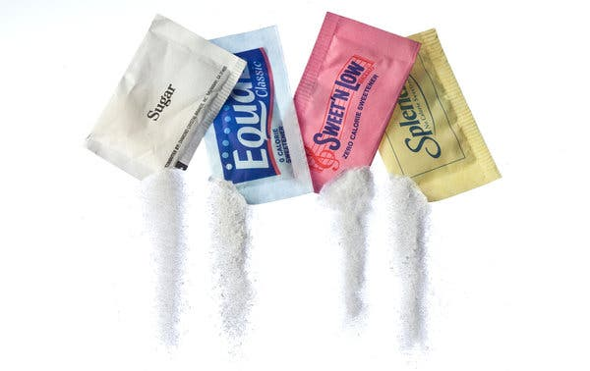
Agenda
Are Artificial Sweeteners Safe or Harmful?
Areas Of Concern
Ethical Concerns
Findings
Next Steps
Challenges/Opportunity
Conclusion

Slide 3
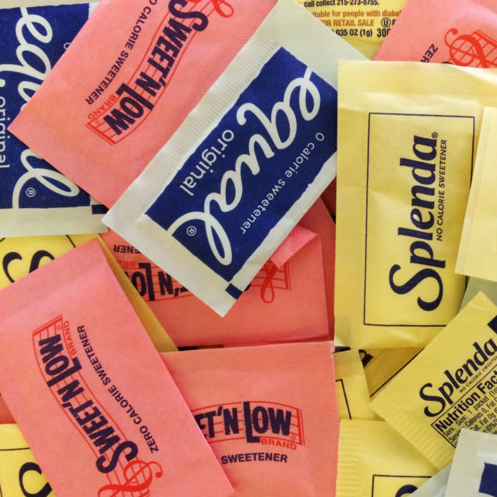
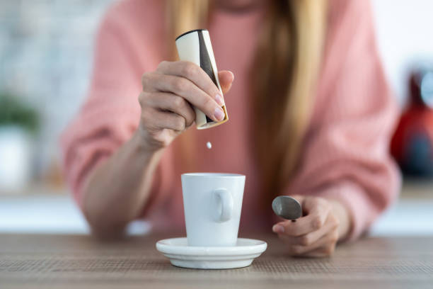
Introduction
Artificial sweeteners, commonly known as sugar substitutes or non-nutritive sweeteners, have gained popularity as alternatives to sugar due to their calorie-free sweetness. Individuals use them widely to reduce sugar intake, manage weight, or control blood sugar levels. However, their safety and potential health effects have been the subject of ongoing debate and research.

Slide 4




Areas of Concern
Health Effects
Appetite & Cravings
Safety & Regulation
Individual Variability
One of the primary concerns associated with artificial sweeteners is their potential impact on health. Studies have suggested artificial sweeteners increase weight gain, appetite, and metabolic disruptions.
The potential influence of artificial sweeteners on appetite and cravings. Some research has suggested that consuming these sweeteners might lead to an increased desire for sweet foods.
Regulatory agencies must maintain transparency and independence in evaluating artificial sweeteners to address public concerns adequately
Individual responses to artificial sweeteners can vary widely based on genetics, metabolism, and pre-existing health conditions

Slide 5



Ethical Concerns
Transparency and Labeling
One ethical concern revolves around the transparency of labeling. Ethical considerations include ensuring that food products containing artificial sweeteners are clearly labeled so consumers can make informed choices.
Marketing and Targeting
There may be ethical concerns regarding the marketing and promoting of artificial sweeteners, for example, if targeted at vulnerable populations, such as children or individuals with health conditions like diabetes.
Access and Socioeconomic Impact
Ethical considerations also extend to issues of access. Some people may not have access to alternatives and may rely on artificial sweeteners, raising questions about the social and economic impact of their use.

Slide 6
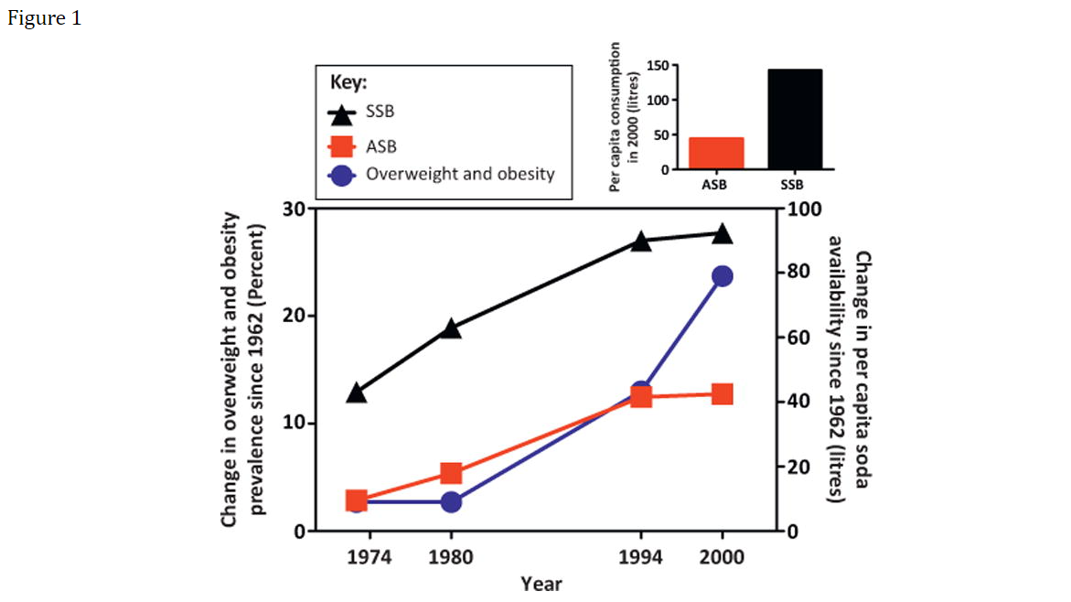
Findings #1 Consumption of Artificially Sweetened beverages & Prevalence of Obesity
The evidence is not entirely consistent, with other studies suggesting that artificial sweeteners can be practical tools for reducing calorie intake and managing weight, particularly for individuals with diabetes or those seeking to control blood sugar levels.
"The line graph shows a deviation in per capita consumption of artificially sweetened beverages (ASB; red squares), sugar-sweetened beverages (SSB; black triangles) and prevalence of obesity (blue circles) in the USA since 1962" (Swithers et al. (2013)).
ASB - Artificially Sweetened Sugar
SSB - Sugar-Sweetened Sugar

Slide 7
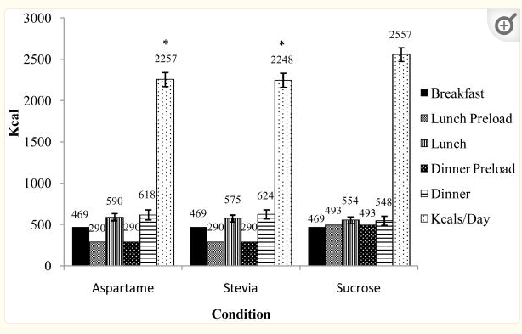
Findings #2 Effect on Appetite and Cravings
Research findings in this area differ, and individual responses to artificial sweeteners can vary widely. While some individuals may experience heightened cravings, others may not be affected
Studies show participants consumed significantly less food over the entire day (including preloads) in the stevia and aspartame conditions as compared to the sucrose condition (mean difference between sucrose and stevia condition = 300 kcal, p < .001; aspartame condition = 334 kcal, p < .001) (Appetite. 2010 Aug; 55(1): 37–43.)

Slide 8
Next Steps Research on artificial sweeteners is ongoing, and findings continue to evolve.
:
Regulatory Oversight
ADI as a Safety Threshold
Individual Variability
The safety assumptions around artificial sweeteners are concerns raised by the rigorous regulatory assessments of agencies like the FDA and EFSA. These agencies conduct extensive research and risk assessments to establish acceptable daily intake levels for these sweeteners.
Individuals to stay below the established acceptable daily intake (ADI) levels, the consumption of artificial sweeteners is considered safe. The ADI includes a significant safety margin.
Assumptions often imply that most individuals can consume artificial sweeteners without adverse effects, but there is recognition that some people may be more sensitive or experience side effects.

Slide 9
Challenges/Opportunities
Opportunities
Taste and Palatability
Health Concerns and Research Opportunities
Sugar Reduction and Obesity
Consumer Education
Alternative Sweeteners
Cultural and Taste Preferences
There are many challenges and opportunities in Artificial Sweeteners space and their impact, effectiveness and applicability on different individuals and culture.

Slide 10


Conclusion
In conclusion, artificial sweeteners are neither universally safe nor inherently harmful. They constitute one element of the broader discussion on nutrition, health, and individual choices in a complex dietary landscape.

Slide 11

Thank you
Deeksha Chawla
dchawla@my365.bellevue.edu

